Slide 2


Slide 3
The Interesting Case of Netflix
Justin Wong Juin Hng P2112646

Slide 4


Slide 5
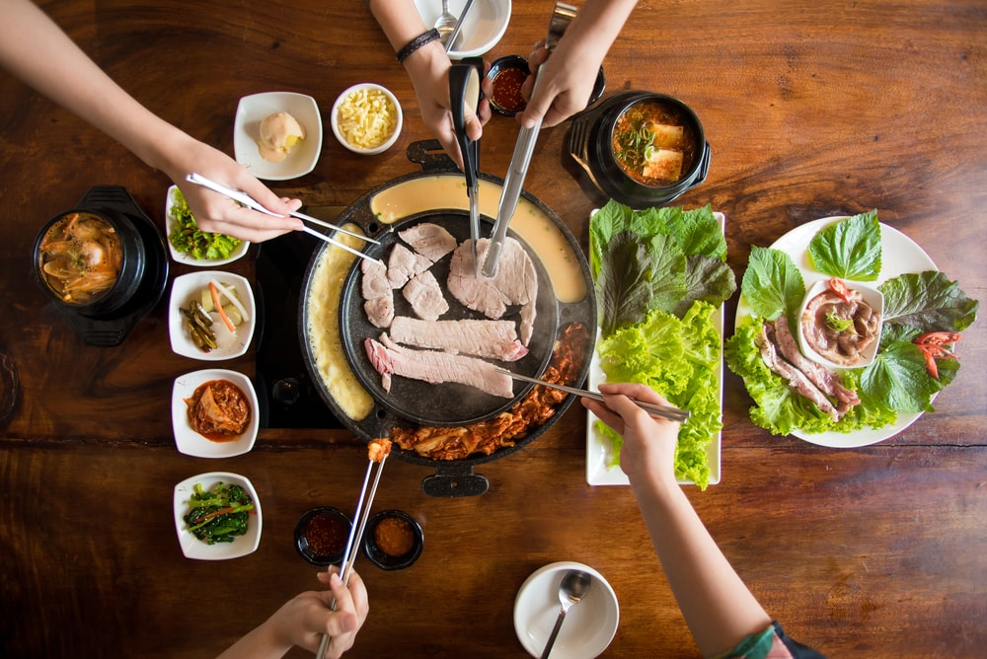

Slide 6


Slide 7


Slide 8


Slide 9

Scarlet Heart Ryeo (2016) Available on Netflix

Slide 10

Hotel Del Luna (2019) Available on Netflix

Slide 11


Slide 12
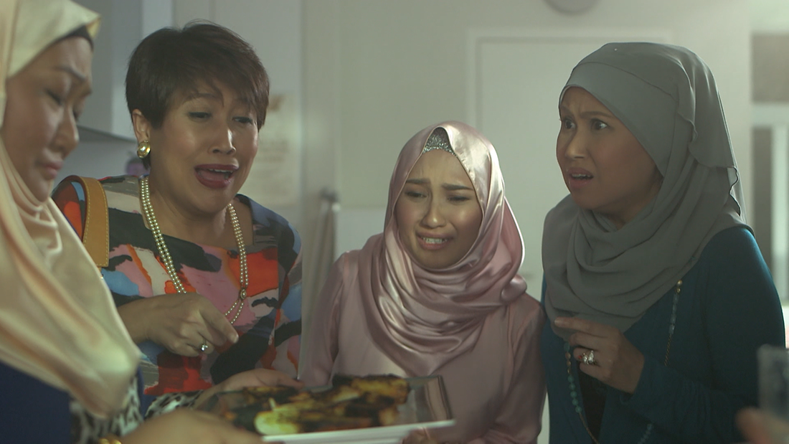
Aduh Bibikku (2017) Available on Netflix

Slide 13
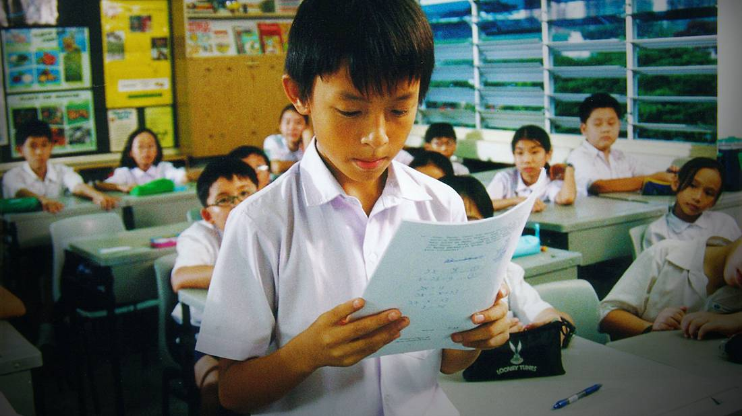
I Not Stupid (2002) Available on Netflix

Slide 14
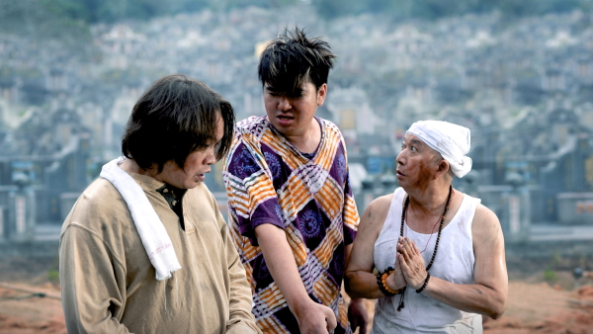
Greedy Ghost (2012) Available on Netflix

Slide 15

Mr. Unbelievable (2015) Available on Netflix

Slide 16
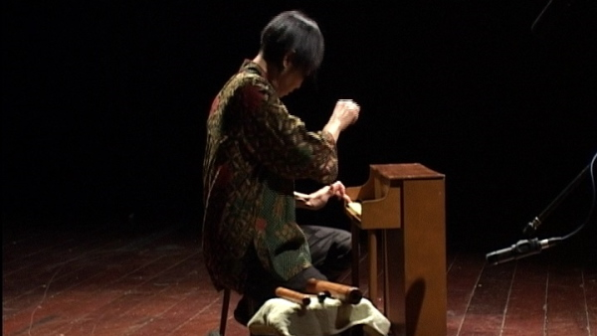
Singapore Gaga (2005) Available on Netflix

Slide 17
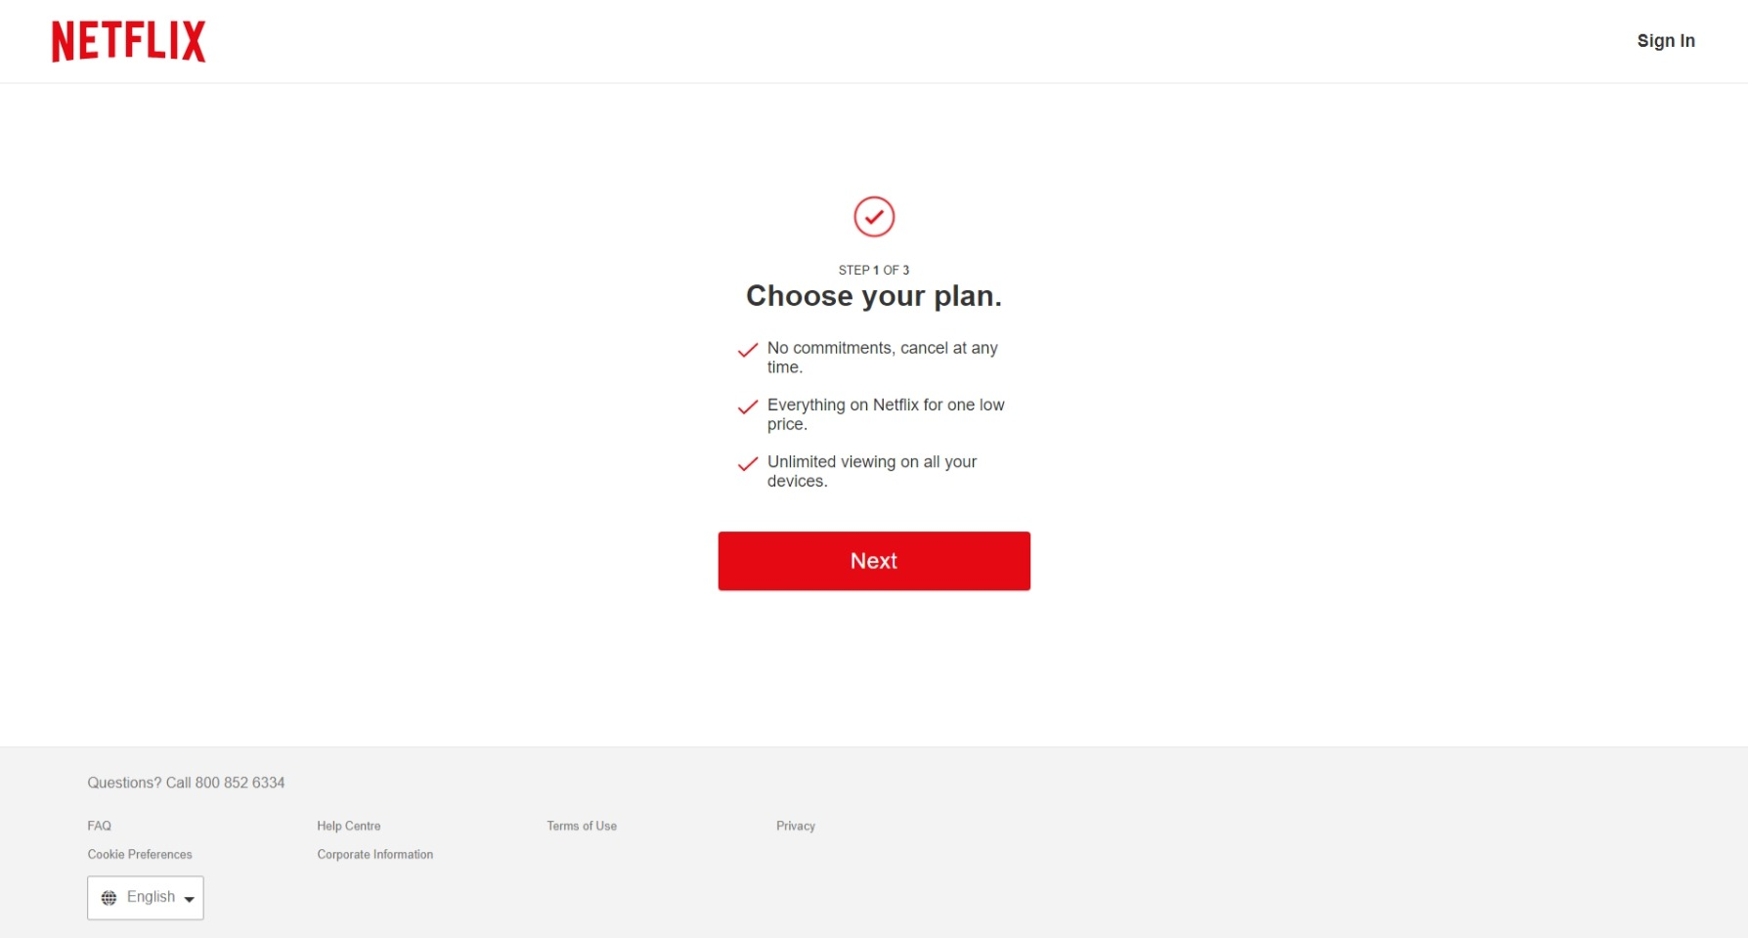

Slide 18
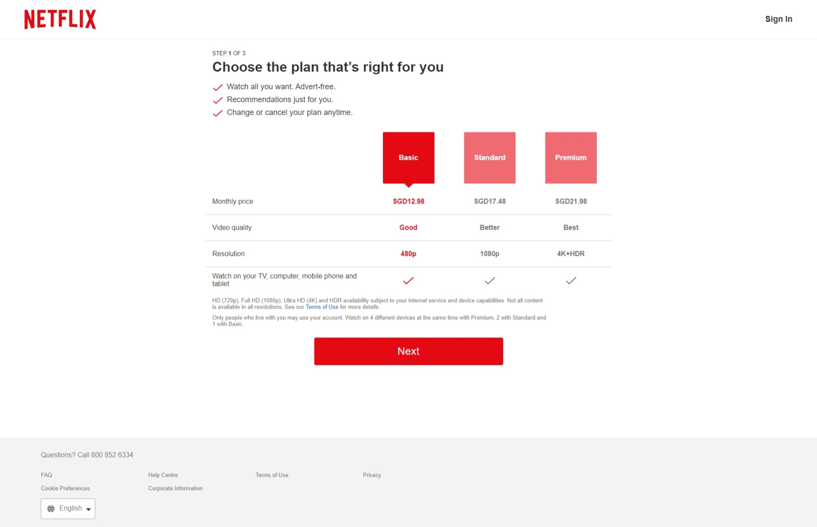

Slide 19
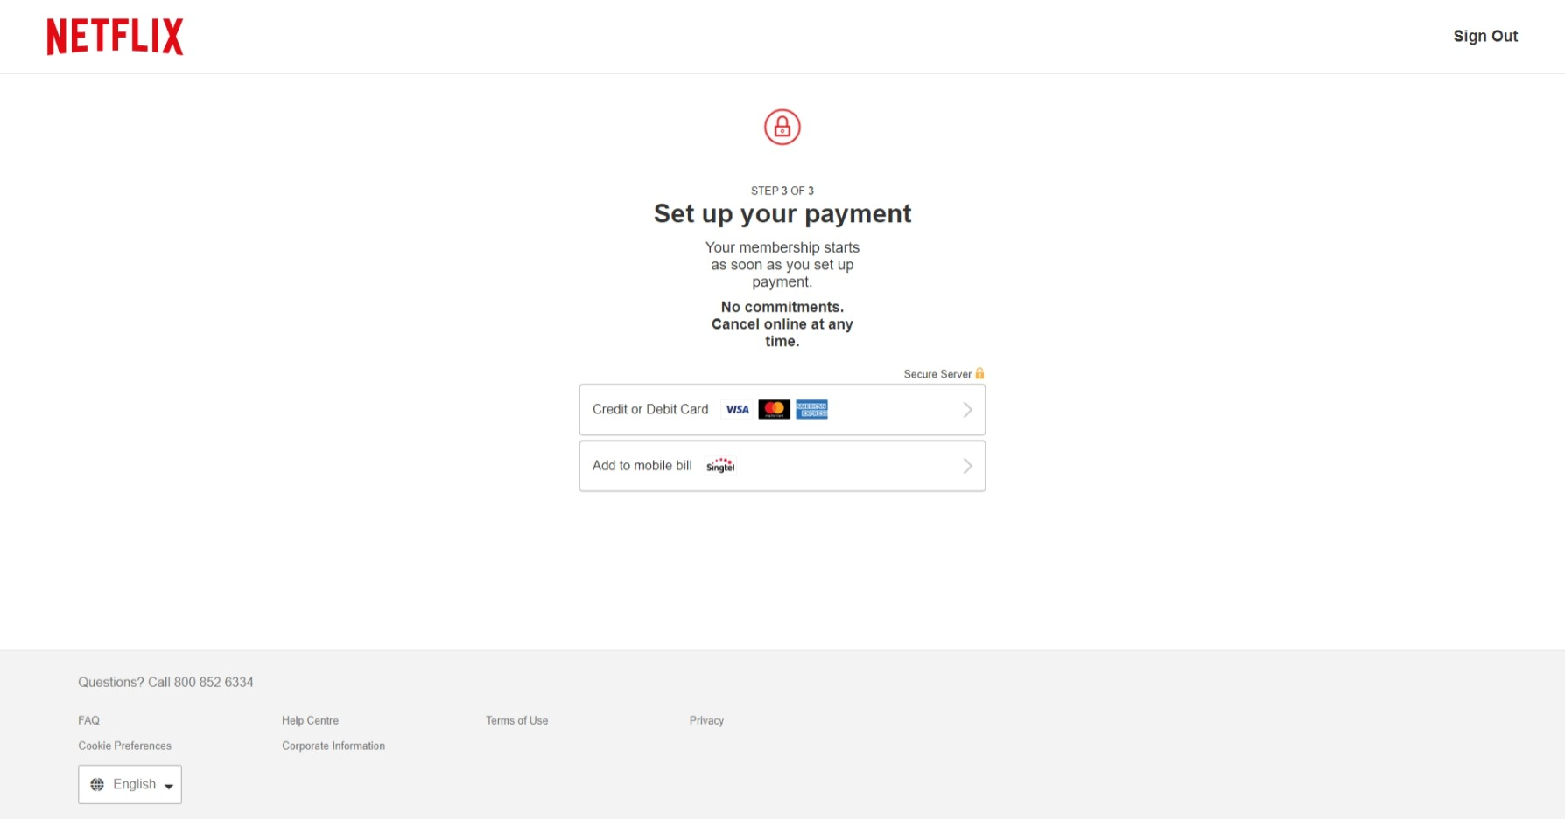

Slide 20
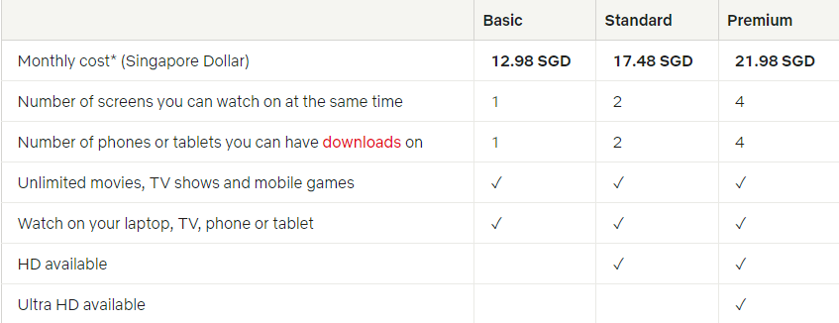

Slide 21
Credits
Moore, K., 2022. How Long Would It Take To Watch All Of Netflix?. [online] What's on Netflix. Available at: <https://www.whats-on-netflix.com/news/how-long-would-it-take-to-watch-all-of-netflix/>
[Accessed 15 January 2022]
Leselfes.com. 2022. What Are the Benefits of Understanding Different Cultures? -. [online] Available at: <https://www.leselfes.com/understanding-different-cultures/>
[Accessed 15 January 2022]
Facing History and Ourselves. 2022. Individual & Society. [online] Available at: <https://www.facinghistory.org/holocaust-and-human-behavior/chapter-1/introduction>
[Accessed 15 January 2022]
Axner, M., 2022. Chapter 27. Working Together for Racial Justice and Inclusion | Section 1. Understanding Culture and Diversity in Building Communities | Main Section | Community Tool Box. [online] Ctb.ku.edu. Available at: <https://ctb.ku.edu/en/table-of-contents/culture/cultural-competence/culture-and-diversity/main>
[Accessed 15 January 2022]

